Slide 1
Capstone Project
Seoul Bike Sharing Demand Prediction
By : Swapnil Aher

Slide 2
Points to discuss
Defining problem statement
Data summary
EDA
Feature engineering
Applying ML algorithms
Comparing different ML models
Conclusion

Slide 3
Defining problem statement
Rental bikes service is very crucial in many urban cities for the enhancement of mobility comfort. It is important to make the rental bike available and accessible to the public at the right time as it lessens the waiting time. Eventually, providing the city with a stable supply of rental bikes becomes a major concern.
Therefore we have to predict the number of rental bikes required in
each hour for smooth functioning of service.

Slide 4
Data Summary
We are given dataset containing count of rental bikes from December 2017 to November 2018 for each day and each hour of day. Along with count of rental bikes there are following variables also present.
Date : year-month-day
Rented Bike count - Count of bikes rented at each hour
Hour - Hour of the day
Temperature-Temperature in Celsius
Humidity - %
Windspeed - m/s
Visibility - 10m
Dew point temperature - Celsius
Solar radiation - MJ/m2
Rainfall - mm
(11)
(12)
(13)
Snowfall - cm
Seasons - Winter, Spring, Summer, Autumn Holiday - Holiday/No holiday
(14) Functional Day - No (Non Functional Hours), Yes(Functional hours)
‘Rented Bike count’ is dependent variable.

Slide 5
Data Summary
Date
Seasons
Holiday
Functional Day
Rented Bike Count
Hour
Temperature
Humidity
Windspeed
Visibility
Dew point temperature
Solar radiation
Rainfall
Snowfall
Categorical
Numerical
Dataset
Dependent variable is ‘Rented Bike Count’ that describes the count of rented bikes for each hour.

Slide 6
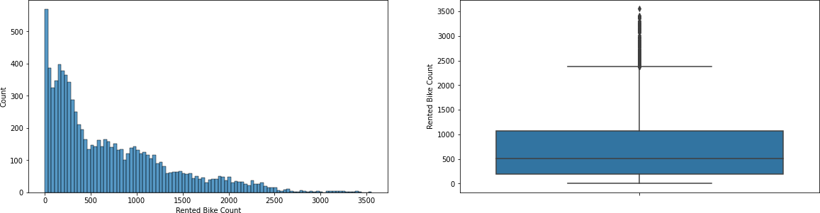
EDA
Let us see how the values of ‘Rented Bike Count’ are distributed in given dataset.
Distribution of values is highly positively skewed.

Slide 7
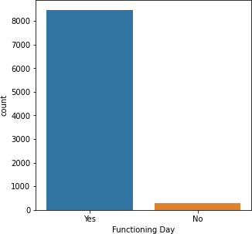
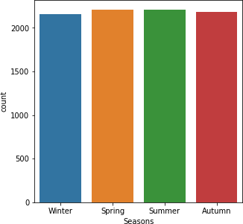
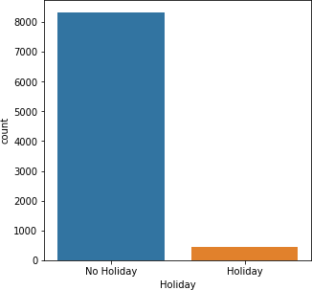
Count of values of categorical features.
Functioning Day and Holiday have highly
imbalanced count of values.

Slide 8
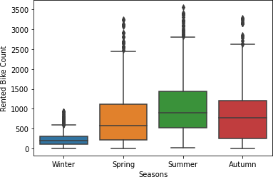
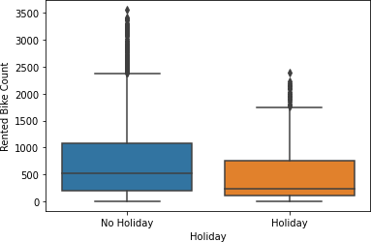
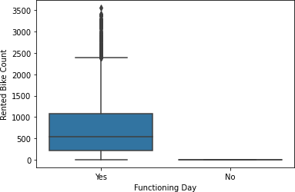
Demand for rented bikes is low in winter seasons and high in summer season.
Demand for rented bikes is low on holidays and non functional days.

Slide 9
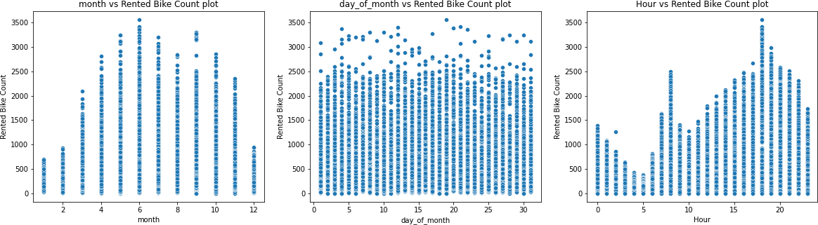
Count of rented bike varies up to higher values from May to September.
Within a month count of rented bikes is almost same.
Demand for rented bikes increases during evening hours.

Slide 10
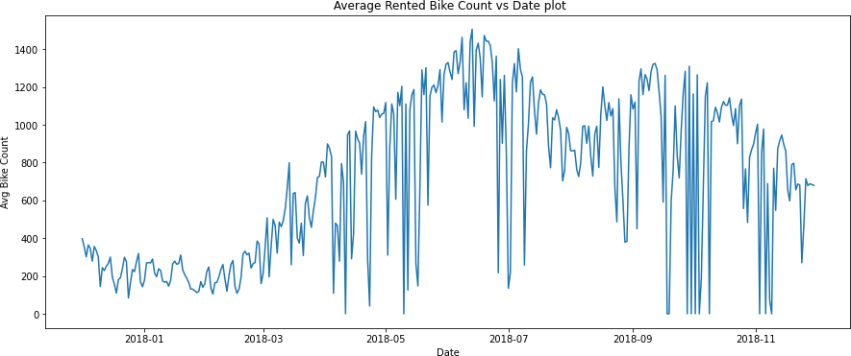
Average rented bike count is comparatively high from middle to end of year.

Slide 11
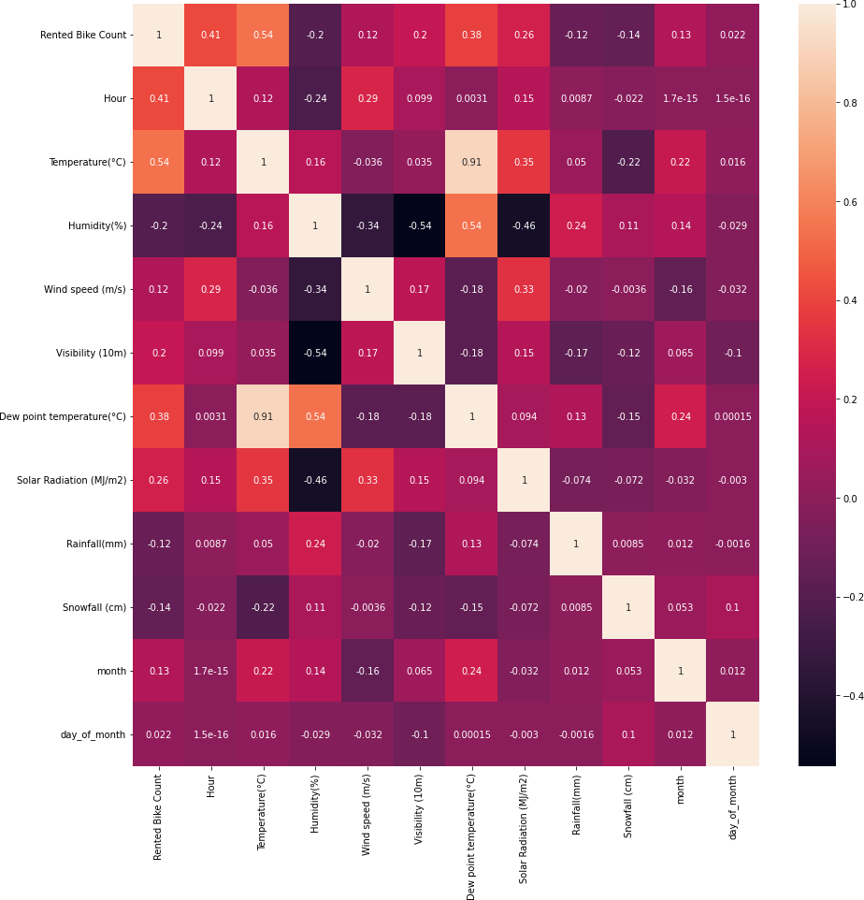
Very high correlation between ‘Temperature’ and ‘Dew point temperature’ which is obvious.
‘Humidity’ is moderately correlated with ‘Solar Radiation’ and ‘Visibility’.

Slide 12
Feature Engineering
Feature engineering is the process of selecting, manipulating, and transforming initial variables into
features that can be used in model training.
New features creation
Day_of_month
Date(day, month. year)
New features created
Month_num

Slide 13
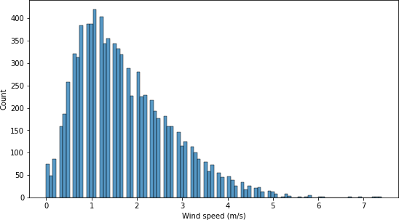
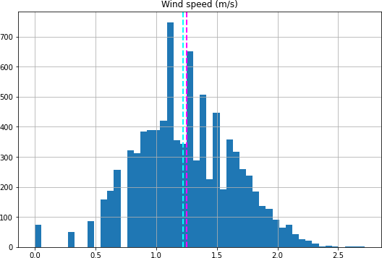
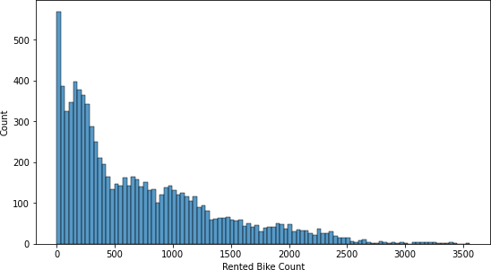
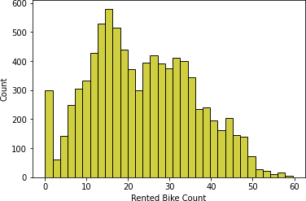
Features transformation
Some of our features are skewed so we can apply sqrt, log10 or reciprocal transformation on them to reduce skewness.
Here we have applied sqrt transformation.
Original Features
Transformed Features
sqrt( wind speed)
sqrt( rented bike count)

Slide 14
Features transformation
Due to presence of categorical features we cant feed data directly in ML algorithm. We need to transform categorical features that have strings datatype to numerical datatype. For which we have used One-hot encoding and label encoding for categorical features.
Seasons
Summer
Winter
Autumn
Spring
Summer | Winter | Autumn | Spring
1 | 0 | 0 | 0
0 | 1 | 0 | 0
0 | 0 | 1 | 0
0 | 0 | 0 | 1
One hot encoding
Similarly for ‘Holiday’ and ‘Functional Day’ feature.

Slide 15
Applying ML Algorithms
Since we have to predict the count of rented bikes required per hour. Hence, we have to use regression algorithms.
Algorithms that we will use are:
Decision Tree
Random Forest
Linear Regression
Lasso Regression
Ridge Regression
Elastic Net Regression

Slide 16
Applying ML Algorithms
Applying supervised ML algorithms have following steps
Preparing data for model
Training and Hyperparameter tuning
Evaluating model on test data

Slide 17

Trainingandhyperparameter tuning
We have trained the models and performed hyperparameter tuning using GridSearchCV and along with that we performed cross validation also.
Following are the optimal parameters of models for which we used GridSearchCV.
Model | Optimal parameters
Decision Tree
Random Forest
Lasso
Ridge
Elastic Net

Slide 18
Evaluatingmodels
Model | Train data – MSE | Test data – MSE | Train data – R2-Score | Test data – R2-Score
Decision Tree | 113611.96 | 125508.38 | 0.727 | 0.699
Random Forest | 64549.49 | 78132.54 | 0.845 | 0.812
Linear Regression | 185109.85 | 193993.06 | 0.38892 | 0.3660
Lasso | 185110.79 | 193970.52 | 0.38813 | 0.3658
Ridge | 185110.49 | 193971.57 | 0.38825 | 0.3661
Elastic Net | 185111.11 | 193962.14 | 0.38822 | 0.3659

Slide 19
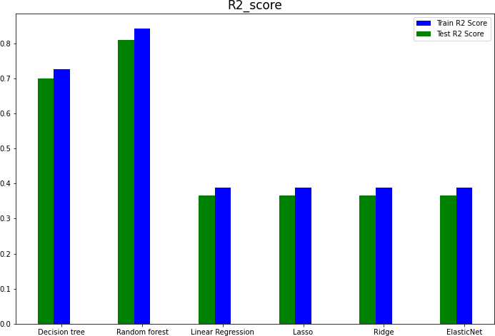
Comparing different ML Models
We evaluated different models on the basis of R2- Score metrics.
And comparing different models we get that Random Forest worked best in predicting the count of rented bikes as its R2- score is maximum from the tried models.

Slide 20
Conclusion
In the given dataset there was no strong linear relation between dependent variable ‘Rented Bike Count’ and independent features. That’s why Linear regression model and its other regularization variant models didn’t performed well.
Out of all models we apply Decision tree and Random forest model are most
accurate. Reason for this are no specific relation between features and large data.
Random Forest performed best as it is an ensemble model and result from multiple decision trees is average out to give the prediction.

Slide 21
Thank you

